Slide 1
Api Marketplace “Categorization”
1 | Description
2 | Terminologies
3 | Key Features
4 | Process Workflow
5 | Key Inputs/Outputs

Slide 2
Description

Slide 3
Descriptions
What is the API Marketplace?
Categorization is an AI-powered service provided by Drahim (an ARG Subsidiary).
It classifies merchants based on their business type and allows customers to modify or update classifications when required.
What is a Categorization?
Categorization Service: An AI-powered solution that classifies merchants into predefined business categories based on their business type and transaction data.
What The Categorization Does:
Automatically classifies merchants using AI.
Allows customers to update or modify classifications when needed.
How It Will Be Used (B2B):
Your business (Consumer) integrates with the API Marketplace to offer merchant categorization services to your customers through digital channels.
Advantages of Categorization (Business View):
Provide accurate merchant classification without building your own AI solution.
Unified and standardized access through the API Marketplace.
Faster time to market for subsidiaries by reusing a ready service.
Centralized monitoring, analytics, and security compliance.
How It Works (Business Flow):
Customers send merchant details → API Marketplace processes → Categorization result is returned.

Slide 4
Terminologies

Slide 5
Terminologies- Business Definitions
Merchant | A business entity that provides goods or services.
Categorization | Assigning merchants into predefined business categories (e.g., Food & Beverage, Electronics, Retail)
Merchant Category Code | Standardized 4-digit code used globally to classify merchants.
Consumer | Subsidiary using the service.
Customer | End user interacting with the categorization service.
1 9

Slide 6


Key Features – Business Perspective

Slide 7
Key Features
1. Categorization Capabilities
Ability to process and classify a bulk list of merchants in a single request.
Automatic classification into predefined business categories using AI.
Support for multiple data attributes (merchant name, type, transaction history, etc.).
Fast response time (2–5 seconds) even for large volumes of merchants.
2. Review & Update Capabilities
Customers can review classification results directly through the digital channel.
Option to modify or update incorrect classifications before final confirmation.
Immediate reflection of updated classifications in the system.
Clear audit trail of changes for monitoring and compliance.
3. Integration & Access
Unified and standardized API access via the API Marketplace.
Scalable architecture to handle increasing transaction volumes.
Consistent categorization logic across all subsidiaries.
4. Reporting & Notifications
Real-time confirmation of categorization requests with unique reference IDs.
Status updates for bulk processing (in-progress, completed, or failed).
Exportable categorized merchant lists for business reporting.
Notifications and logs stored centrally for monitoring and analytics.

Slide 8
Process Workflow

Slide 9
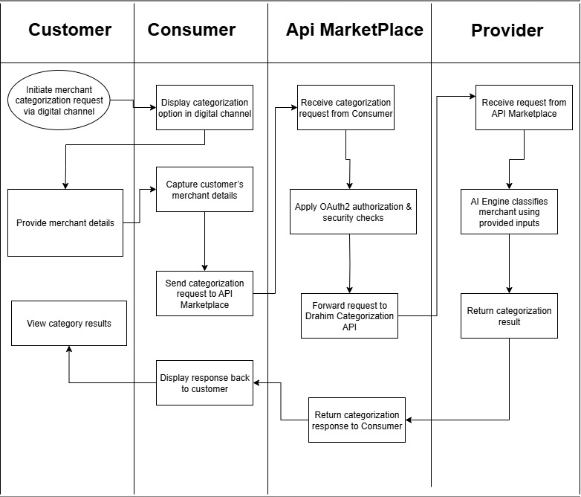

Slide 10
Use Cases
Customer
Submit bulk categorization request
Review results
Update classifications if needed
Forward request to API Marketplace
Display results to customer
API Marketplace
Validate & secure request
Route to Categorization Provider
Return results to subsidiary
Provider
Process merchant list with AI
Generate categorized results
Send results back to Marketplace
Consumer
Provide digital channel interface

Slide 11
Inputs & Outputs – Business Keys

Slide 12
Purpose: Explain what the client needs to provide and what they will get from the APIs.
Inputs (Business Perspective):
Customer identification details (basic account or login information).
Bulk merchant list (merchant names, IDs, and attributes).
Transaction or business activity data for each merchant.
Optional classification parameters (e.g., category type, rules).
Outputs (Business Perspective):
Categorized merchant list with assigned business categories.
Confirmation of successful processing with unique request IDs.
Status of request (in-progress, completed, or failed).
Updated classifications reflecting any customer modifications.
Exportable categorized data for reporting or analytics.

